Slide 1
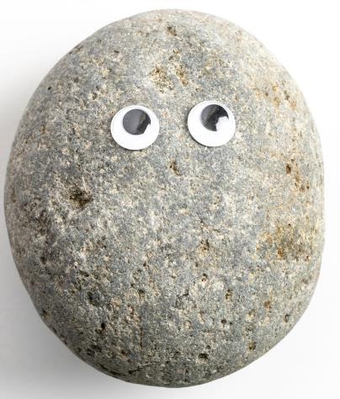


There are only three basic categories of rocks.
My Rock
The Rock
Actual Rock

Slide 2
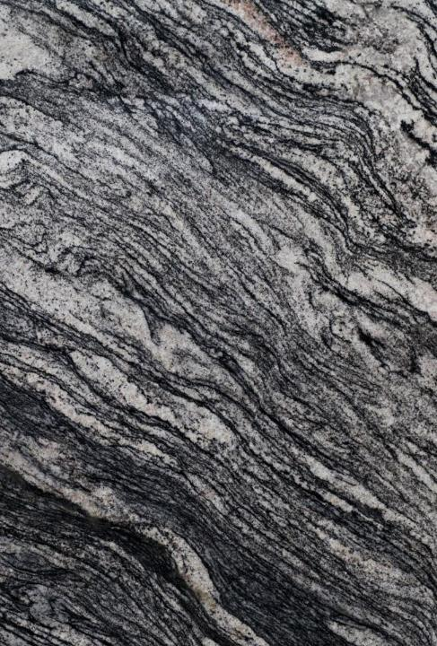
Identify the three main types of rock.
A). Granite, basalt and limestone
B). Sedimentary, igneous and metamorphic
C). Intrusive, extrusive and metamorphic

Slide 3
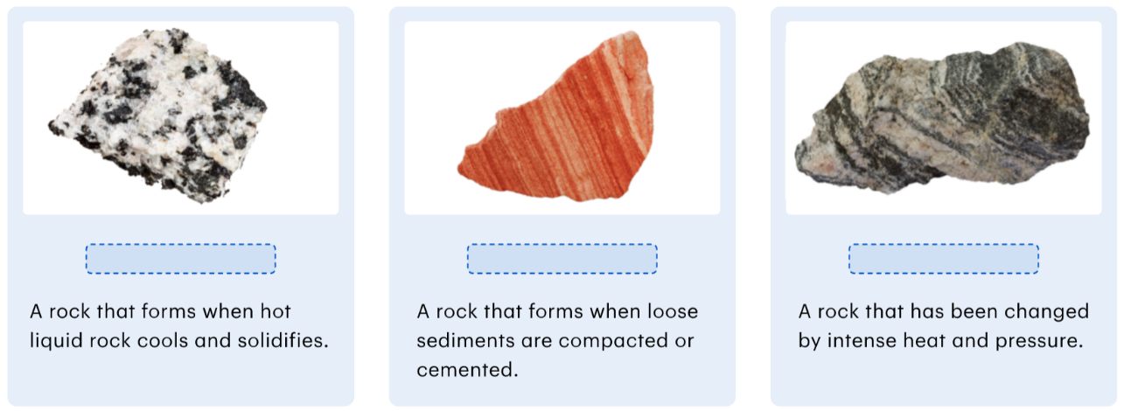
Identify the three main types of rock.
Word bank: metamorphic, sedimentary, igneous

Slide 4
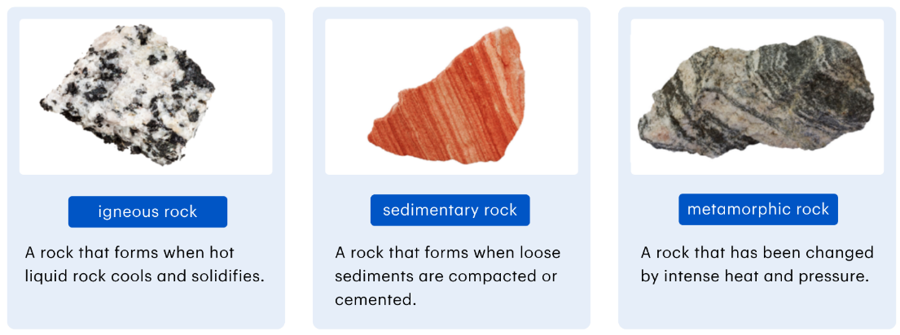

Slide 5

Select the option that best completes the following sentence.
Rocks are classified into three main types depending on:
A). where they are found
B). how old they are
C). how they were formed
D). their colour

